Slide 1


Assignment 6
Project Mentors :
Mrs. Priya R.L ,
Mrs. Nusrat Ansari
Group Number : 30
Group Members : J N Guru Akaash D17A 28
Ajay Nair D17A 55
Manigandhan K D17A 47
Varun Tripathy D17A 69

Slide 2
Content
Introduction to the Assignment
Methodology employed
Results and implementation screenshots
Conclusion

Slide 3
Introduction to the assignment
Task Given
Create an annotation tool in Python.
Perform the training of both Keras OCR and Easy OCR models.
Integrate both these models into a single functional file.
Solution Introduction
The annotation tool was extracted from previous projects and modified to run in our project.
Desired dataset was gathered and annotations were done to create appropriate ground truth files according to the specifications of the used models.
These detection (Keras OCR) and recognition (Easy OCR) models were trained using their respective dataset and annotations separately and evaluation was done.
The weights obtained after training were loaded to these models respectively and they were integrated into a single functional python file.

Slide 4
Methodology employed
Training Keras OCR detector:
Keras OCR is a slightly polished and packaged version of the Keras CRNN implementation and the published CRAFT text detection model. It provides a high level API for training a text detection and OCR pipeline.
Keras OCR detector model was trained by fine-tuning it on our custom dataset to correctly identify the region of interest in case of our use case.
The custom dataset had 41 images with 9831 character annotations in Pascal VOC XML format.
Then the XML file was converted to a format as specified by Keras OCR detector module.
Weights obtained after training can be loaded into the model attribute of the detector which can be reused later for detecting ROIs.
Notes:
Keras Dataset: 41 images and 9831 tuples
https://colab.research.google.com/drive/11-vaXaEgNdGTukYsefdzKj_ovDa7Yxnq#scrollTo=HptnUvGH8cSV
Fine-tuning CRAFT detector , character level annotations

Slide 5
Methodology employed
Training Easy OCR
Easyocr was trained on a custom dataset fine-tuning it to correctly perform the detection of text on the given region of interest.
EasyOCR uses VGG and DBNet architecture to train their recognition model, to train our custom model we need to crop the image in specific height and create a labels.csv file where name of each file and the contents of the file are to be used.
This file and the dataset is then passed to the EasyOCR training script where the model is trained on this dataset for 3,00,000 iteration and then the weight files are used inside the root folder from where easyocr can access the custom model and use the custom model for recognizing the text inside the bounding box.
Notes:
Keras Dataset: 41 images and 9831 tuples
https://colab.research.google.com/drive/11-vaXaEgNdGTukYsefdzKj_ovDa7Yxnq#scrollTo=HptnUvGH8cSV
Fine-tuning CRAFT detector , character level annotations

Slide 6
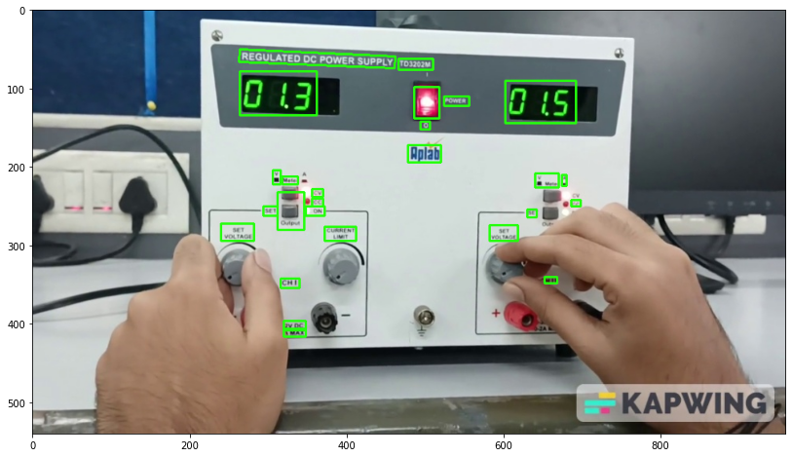
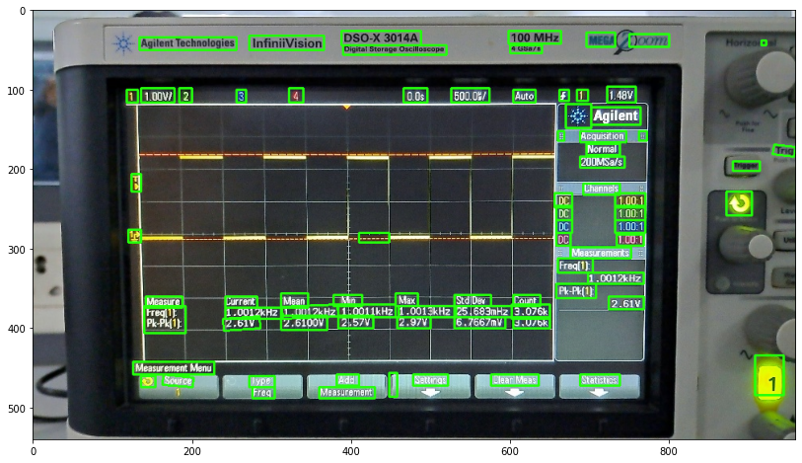
Results and implementation screenshots
Results after training Keras OCR detection models
Notes:
https://colab.research.google.com/drive/11-vaXaEgNdGTukYsefdzKj_ovDa7Yxnq#scrollTo=HptnUvGH8cSV

Slide 7
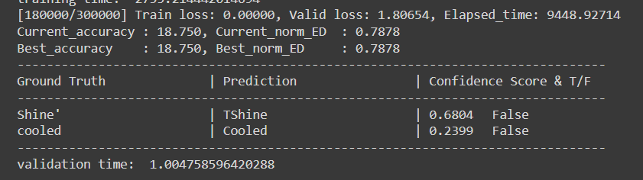
Results and implementation screenshots
EasyOCR training
180000/300000 iteration of training

Slide 8
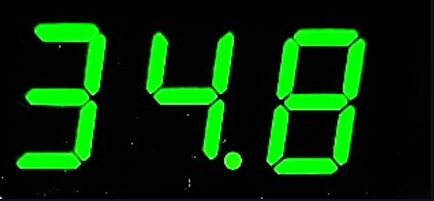
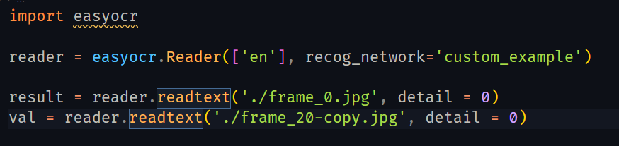
Results and implementation screenshots
Results after training Easy OCR recognition models
Result of EasyOCr on above image
Notes:
https://colab.research.google.com/drive/11-vaXaEgNdGTukYsefdzKj_ovDa7Yxnq#scrollTo=HptnUvGH8cSV

Slide 9
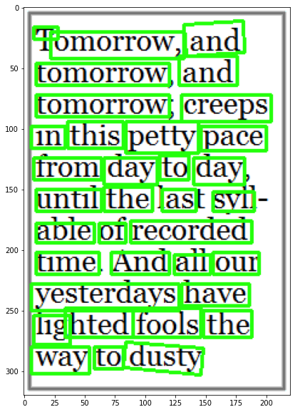
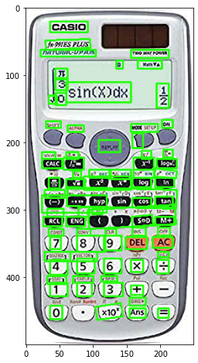
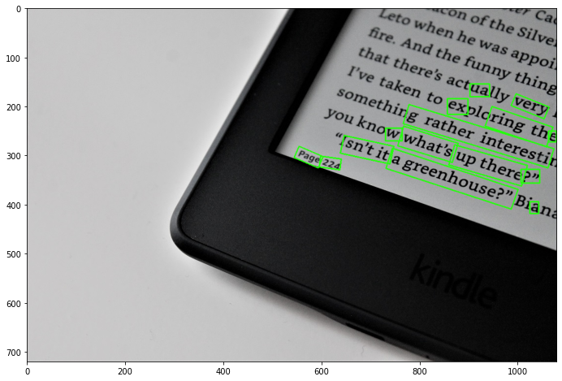
Results and implementation screenshots
Results after training Keras OCR detection models
Fig 3: Rotated text
Fig 1: Long text
Fig 2: Calculator

Slide 10
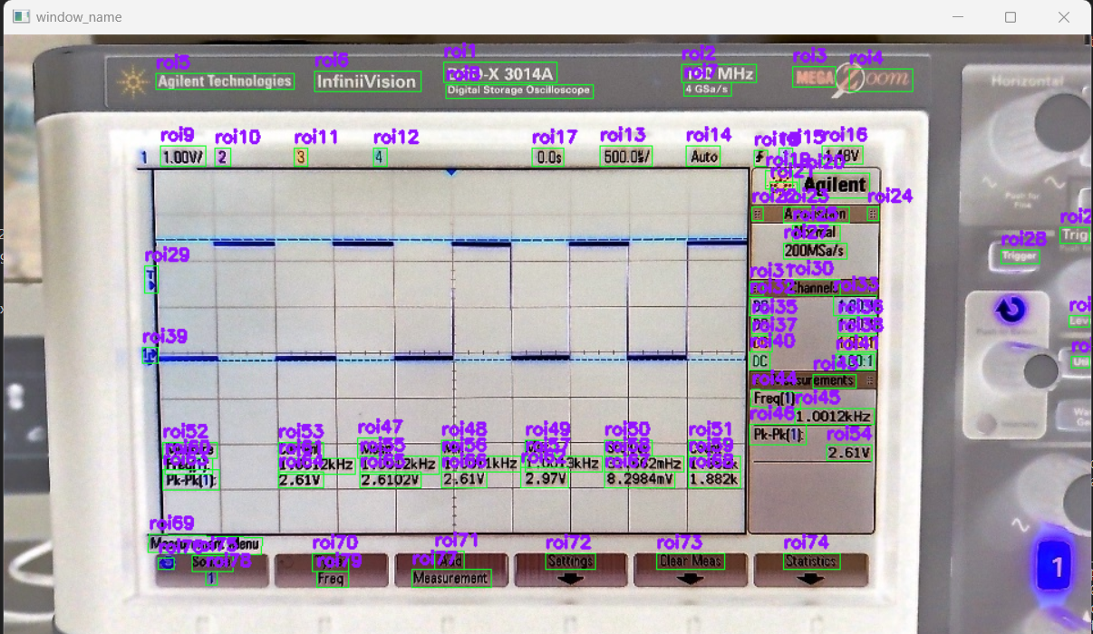
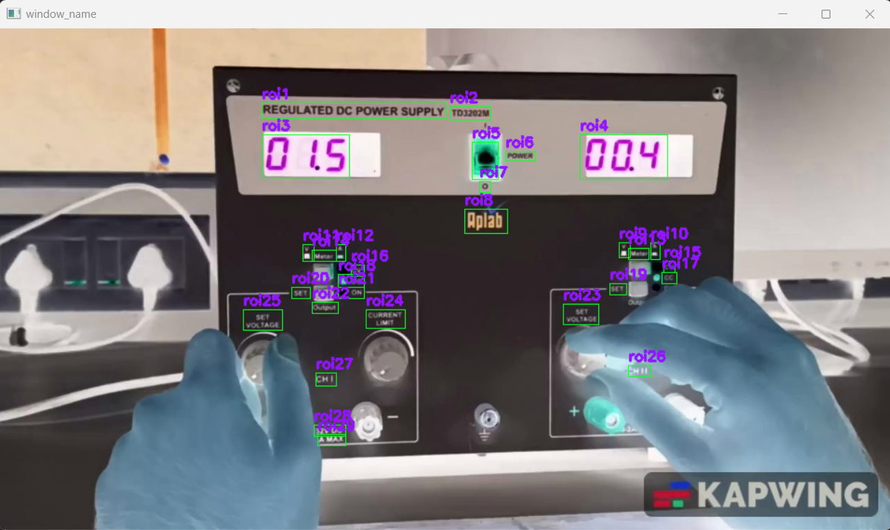
Results and implementation screenshots
Keras OCR and Easy OCR integrated detector model’s results
Fig 4: DSO
Fig 5: Power Supply

Slide 11
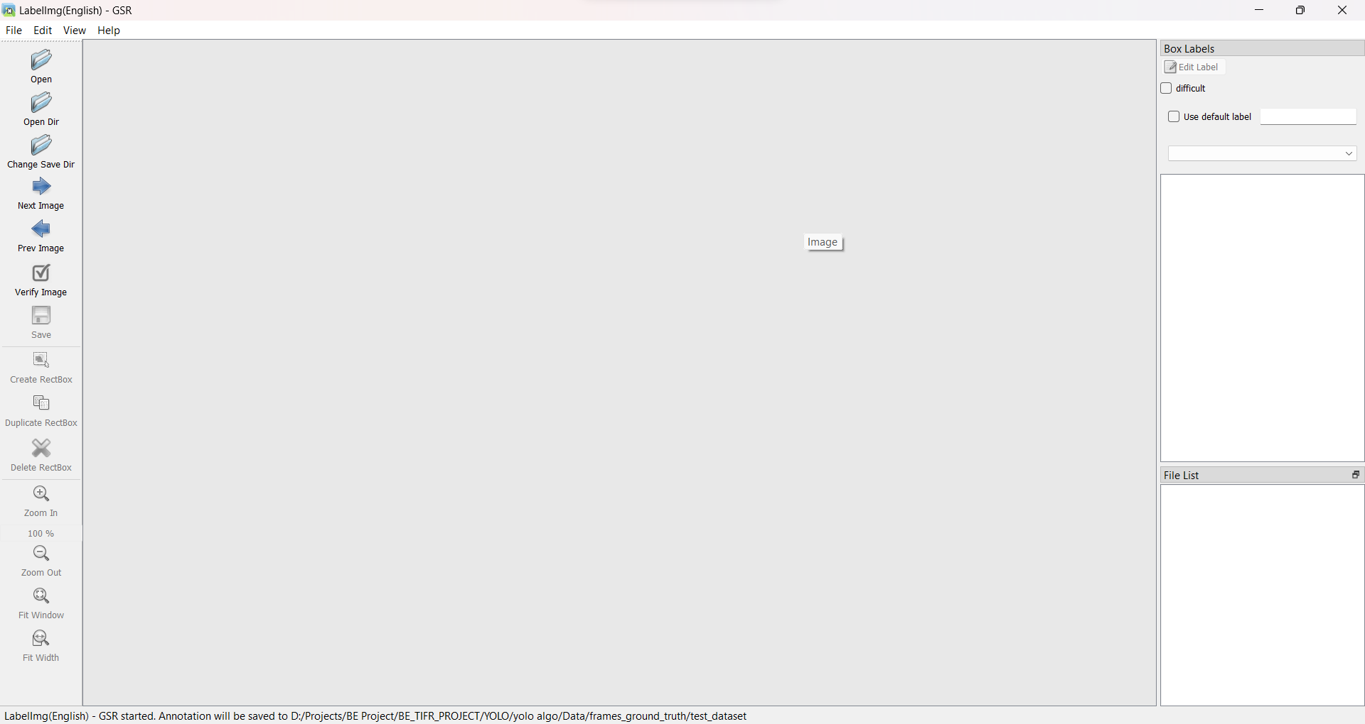
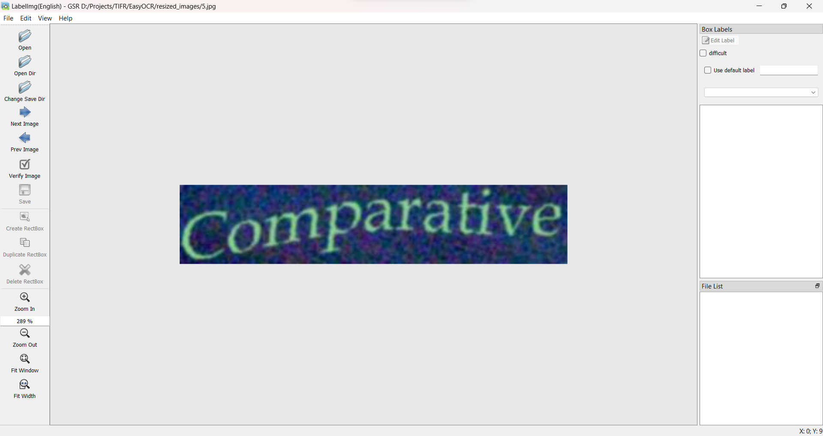
Results and Implementation Screenshots
Annotation Tool

Slide 12
Evaluation Results of Detector Model
Fig No. | Fig Name | Actual ROIs | ROIs detected by original model | ROIs detected by custom trained model
1 | Long Text | 33 | 33 | 35
2 | Calculator | 55 | 9 | 48
3 | Rotated Text | 38 | 41 | 15
4 | DSO | 77 | 81 | 85
5 | Power Supply | 26 | 14 | 24

Slide 13
Conclusion
An annotation tool using LabelIng was created for training purposes.
Datasets were created with their appropriate annotations.
Training of both detection and recognition models are completed and integrated in our application.
We can improve on our training using more images as dataset after annotating them.
Dataset for training on YOLO models will be created.
Now training will be done for YOLO models for text detection and recognition.

